Slide 1
Android Programming

Slide 2
Android
Android is an opensource platform for mobile devices. Android is a popular platform for mobile devices. Android programming education is important. Android programming education is efficient.

Slide 3
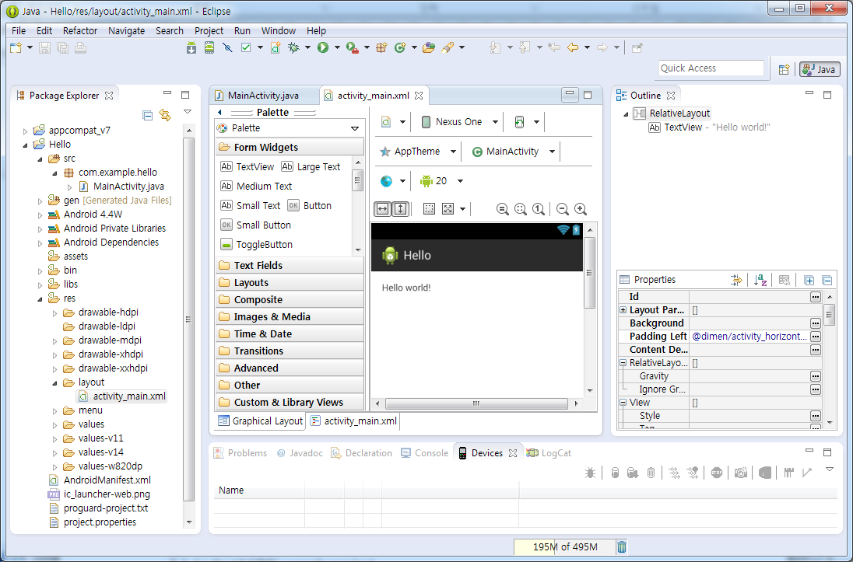

Slide 4
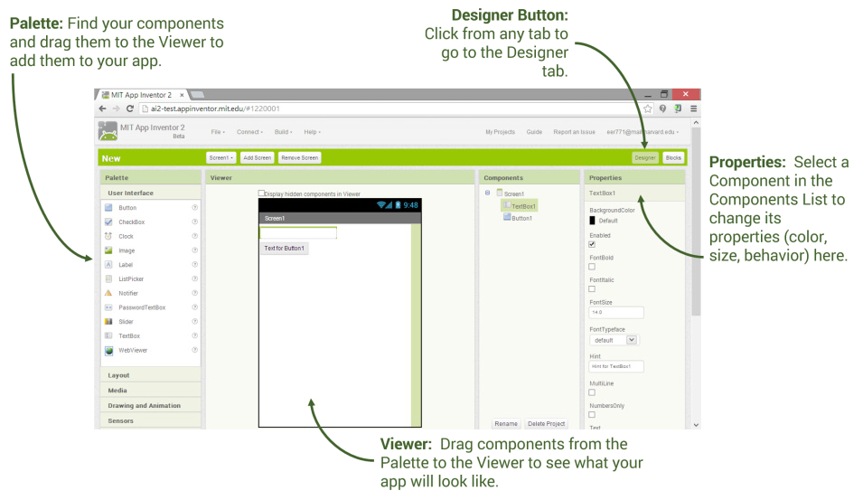

Slide 5
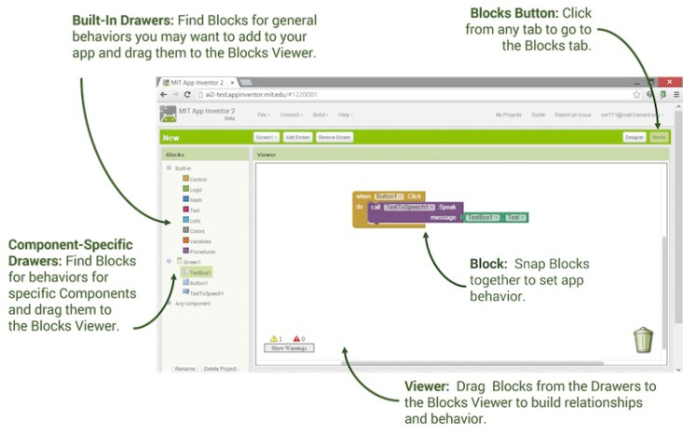

Slide 6
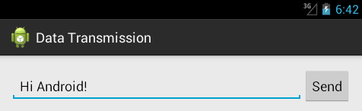

Slide 7
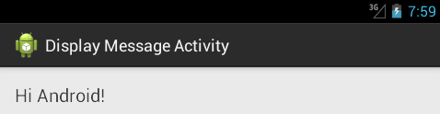

Slide 8
Android App Development
In this paper, we introduce the Android app development skills using App Inventor. We explain the basic skills of Android app development. We also introduce the sample project for Android app development.

Slide 9
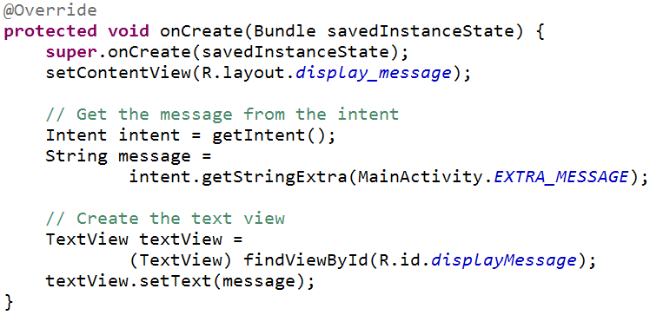

Slide 10
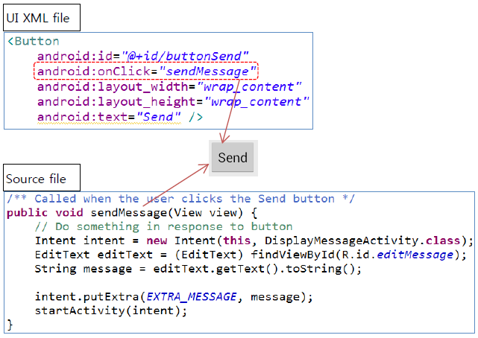

Slide 11
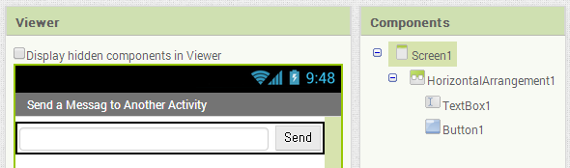

Slide 12
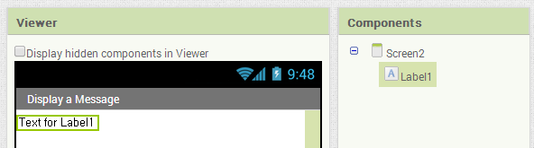

Slide 13
Android
This paper presents a new model for Android programming education using multi Android development tools. This model is composed of Android SDK and MIT App Inventor. This model can be more efficient than the education using Android SDK only.

Slide 14
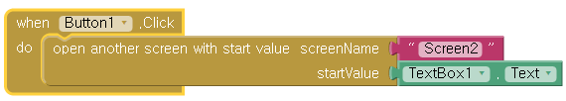

Slide 15


Slide 16
Android App Development
The Android app development education model designed in this study, using multi Android development tools have shown to be more efficient compared to education using Android SDK only.

